Slide 1

6th SEM PROJECT REPORT On FACE RECOGNITITON SYSTEM (CSE VI SEM MINI PROJECT) 2021-22
Submitted By:
Kanika Pathak
Roll no: 1918405
CSE
Section -D

Slide 2
1. Introduction
What's Face Recognititon? Face recognition is among the most productive image processing operations and has a vital part in the specialized field. Recognition of the mortal face is an active issue for authentication purposes specifically in the environment of attendance of scholars. A facial recognition software captures and compares patterns on a person’s face and analyses the details to identify and corroborate the existent. While the underpinning system is complex, the whole technology can be broken down into three way. Face Discovery An essential step is locating mortal faces in real- time Transform Data Once captured, the analogue facial information is converted into a set of data or vectors grounded on a person’s facial features. Face Match The system matches the data over with the one in the database for verification nearly every big tech company including Amazon, Google,Microsoft,andCiscois leading the trouble to make face recognition more mainstream.

Slide 3
SOFTWARE REQUIREMENTS
Language : python3.8
Operating system : Window10
HARDWARE REQUIREMENTS
Processor : Intel core i3 7th Gen
Random Memory : 128MB
Hard Disk : 20GB
Processor Speed : 300 min

Slide 4

4. DATASET

Slide 5
5. Technique used:
But face recognition is really a series of several related problems:
First, look at a picture and find all the faces in it
2.Second, focus on each face and be able to understand that even if a face is turned in a weird direction or in bad lighting, it is still the same person.
3.Third, be able to pick out unique features of the face that you can use to tell it apart from other people— like how big the eyes are, how long the face is, etc.
4.Finally, compare the unique features of that face to all the people you already know to determine the person’s name.

Slide 6
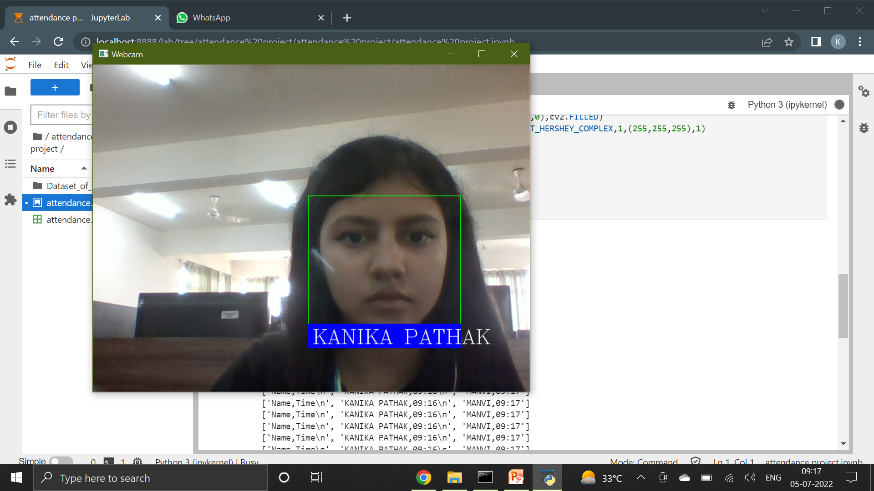
Face recognititon

Slide 7
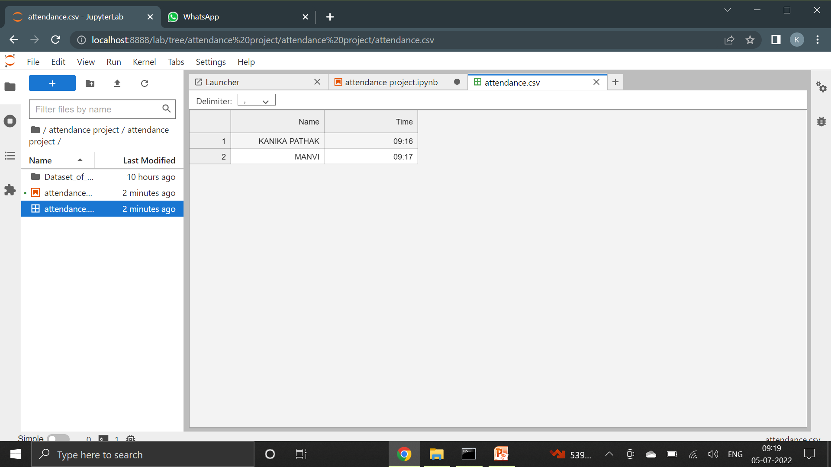
Mark Attendence

Slide 8
9. LANGUAGE USED
Python
Python is widely used in scientific and numeric computing:
Numpy is a numerical python library for analysis of numbers.
OpenCV is a library using which we can detect faces and apply different machine learning algorithms in it.

Slide 9
Thank You !

